Slide 1

Unlock Real-Time Insights with Fabric & Power BI
Kristyna Ferris
Fun Fact: this font is dyslexic friendly! Ask me how to use it for free after the session.
Notes:
Open-Dyslexic Font | dafont.com
Download the font from Open-Dyslexic Font | dafont.com
Extract the files
Go to computer settings > personalization > fonts and drop in the files
Navigate to Power Point Master Slide
Change the font to use Open Dyslexic for the headers and body
Done!

Slide 2

About Me ~ Kristyna Ferris
Microsoft MVP, Data Platform & Fabric Solution Architect, P3 Adaptive Lexington Data Tech Group co-organizer DataOnWheels Author
Blog
https://dataonwheels.wordpress.com/ LinkedIn
https://www.linkedin.com/in/kristyna-ferris-dataonwheels/
Twitter & Bluesky
@data_dragoness

Slide 3
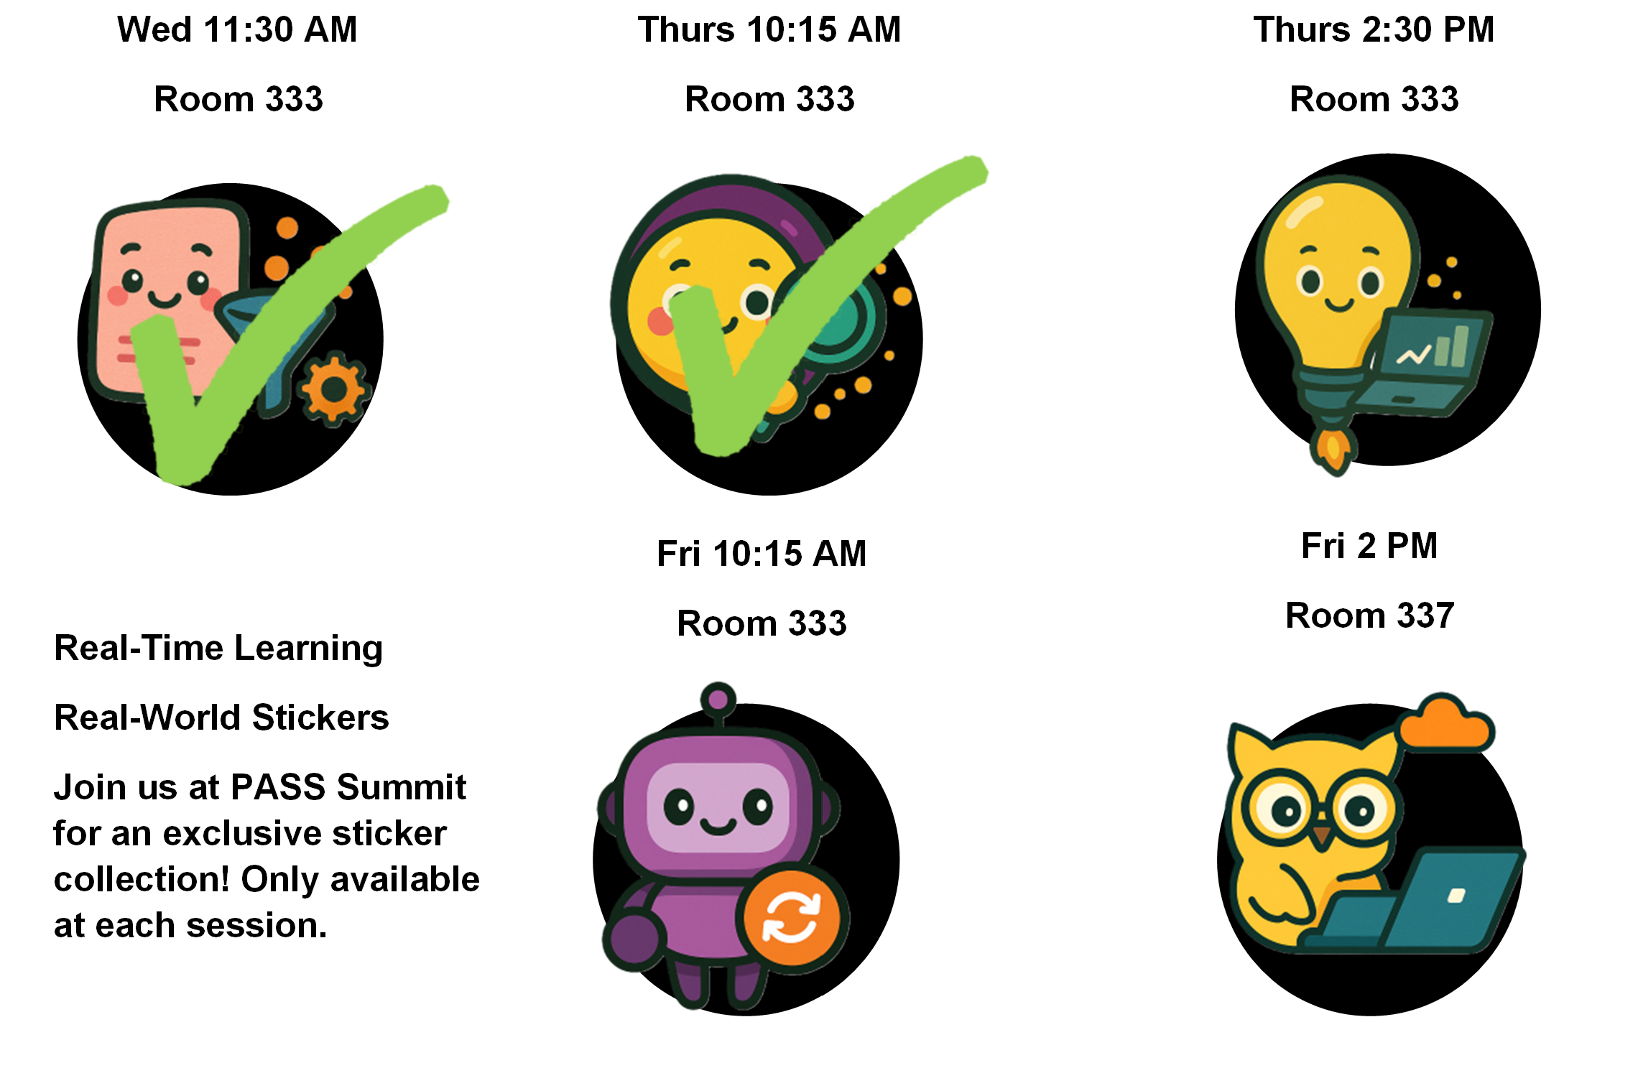
Don’t forget to get your sticker after the session!
Notes:
Additional resources:
Microsoft Fabric Real-Time Dashboard Tutorial | Step-by-Step Guide with Live Examples
Step-by-Step Guide to Real-Time Dashboards with Microsoft Fabric – Data Analytic Group (DAG)

Slide 4

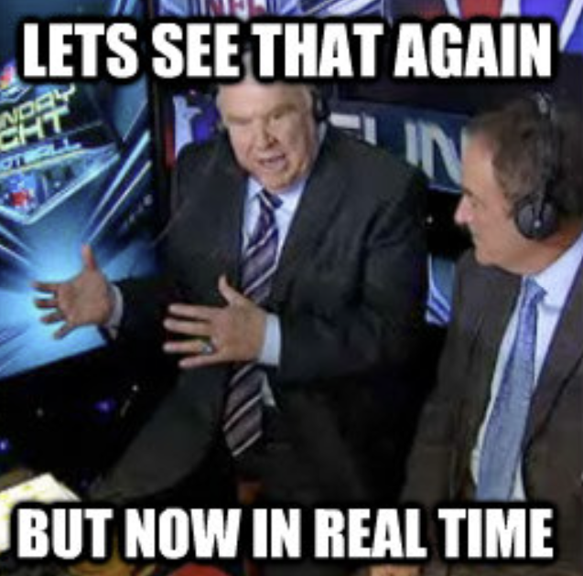
Fabric Real-Time Dashboards (RTD)
Ideal Use Cases
Internet of Things (IoT) telemetry dashboards
High-frequency metrics (CPU, sensors, website logs)
Application monitoring / observability
Fraud detection / anomaly detection
Manufacturing floor dashboards
Vehicle telematics
Clickstream analytics
Live feeds requiring sub-minute refresh

Slide 5
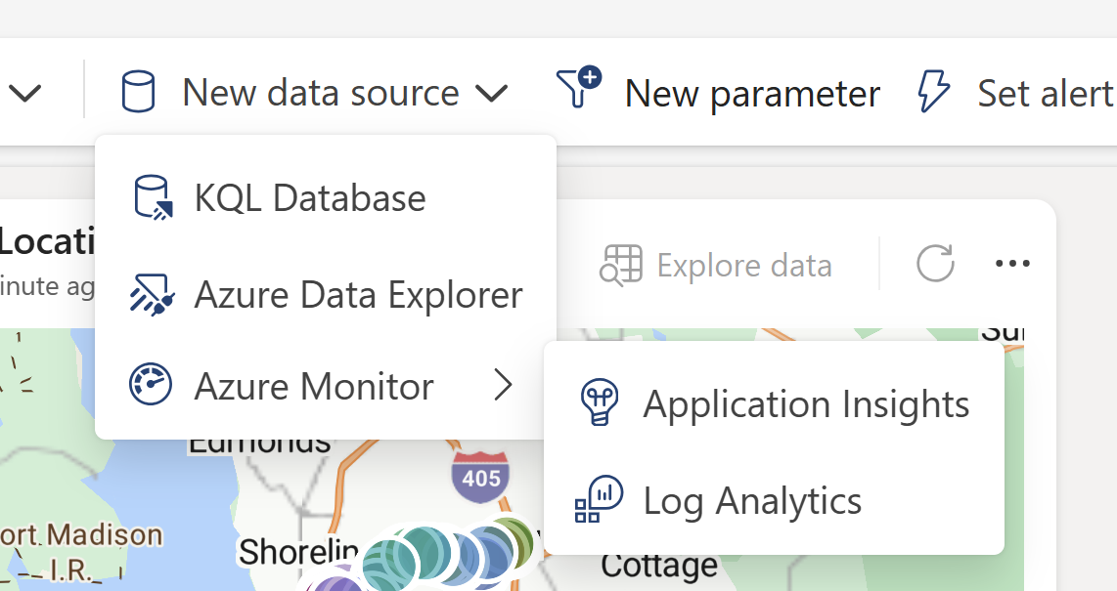
Fabric RTD Sources
Where can you get data from?
KQL Database (eventhouse tables)
Azure Data Explorer
Azure Monitor
If it lands in a KQL database, it can power a Real-Time Dashboard.
Use event streams to load data into KQL from sources including:
MQTT
AMQP
Kafka
Azure Event Hubs
Azure IoT Hub
Webhooks
Custom apps

Slide 6
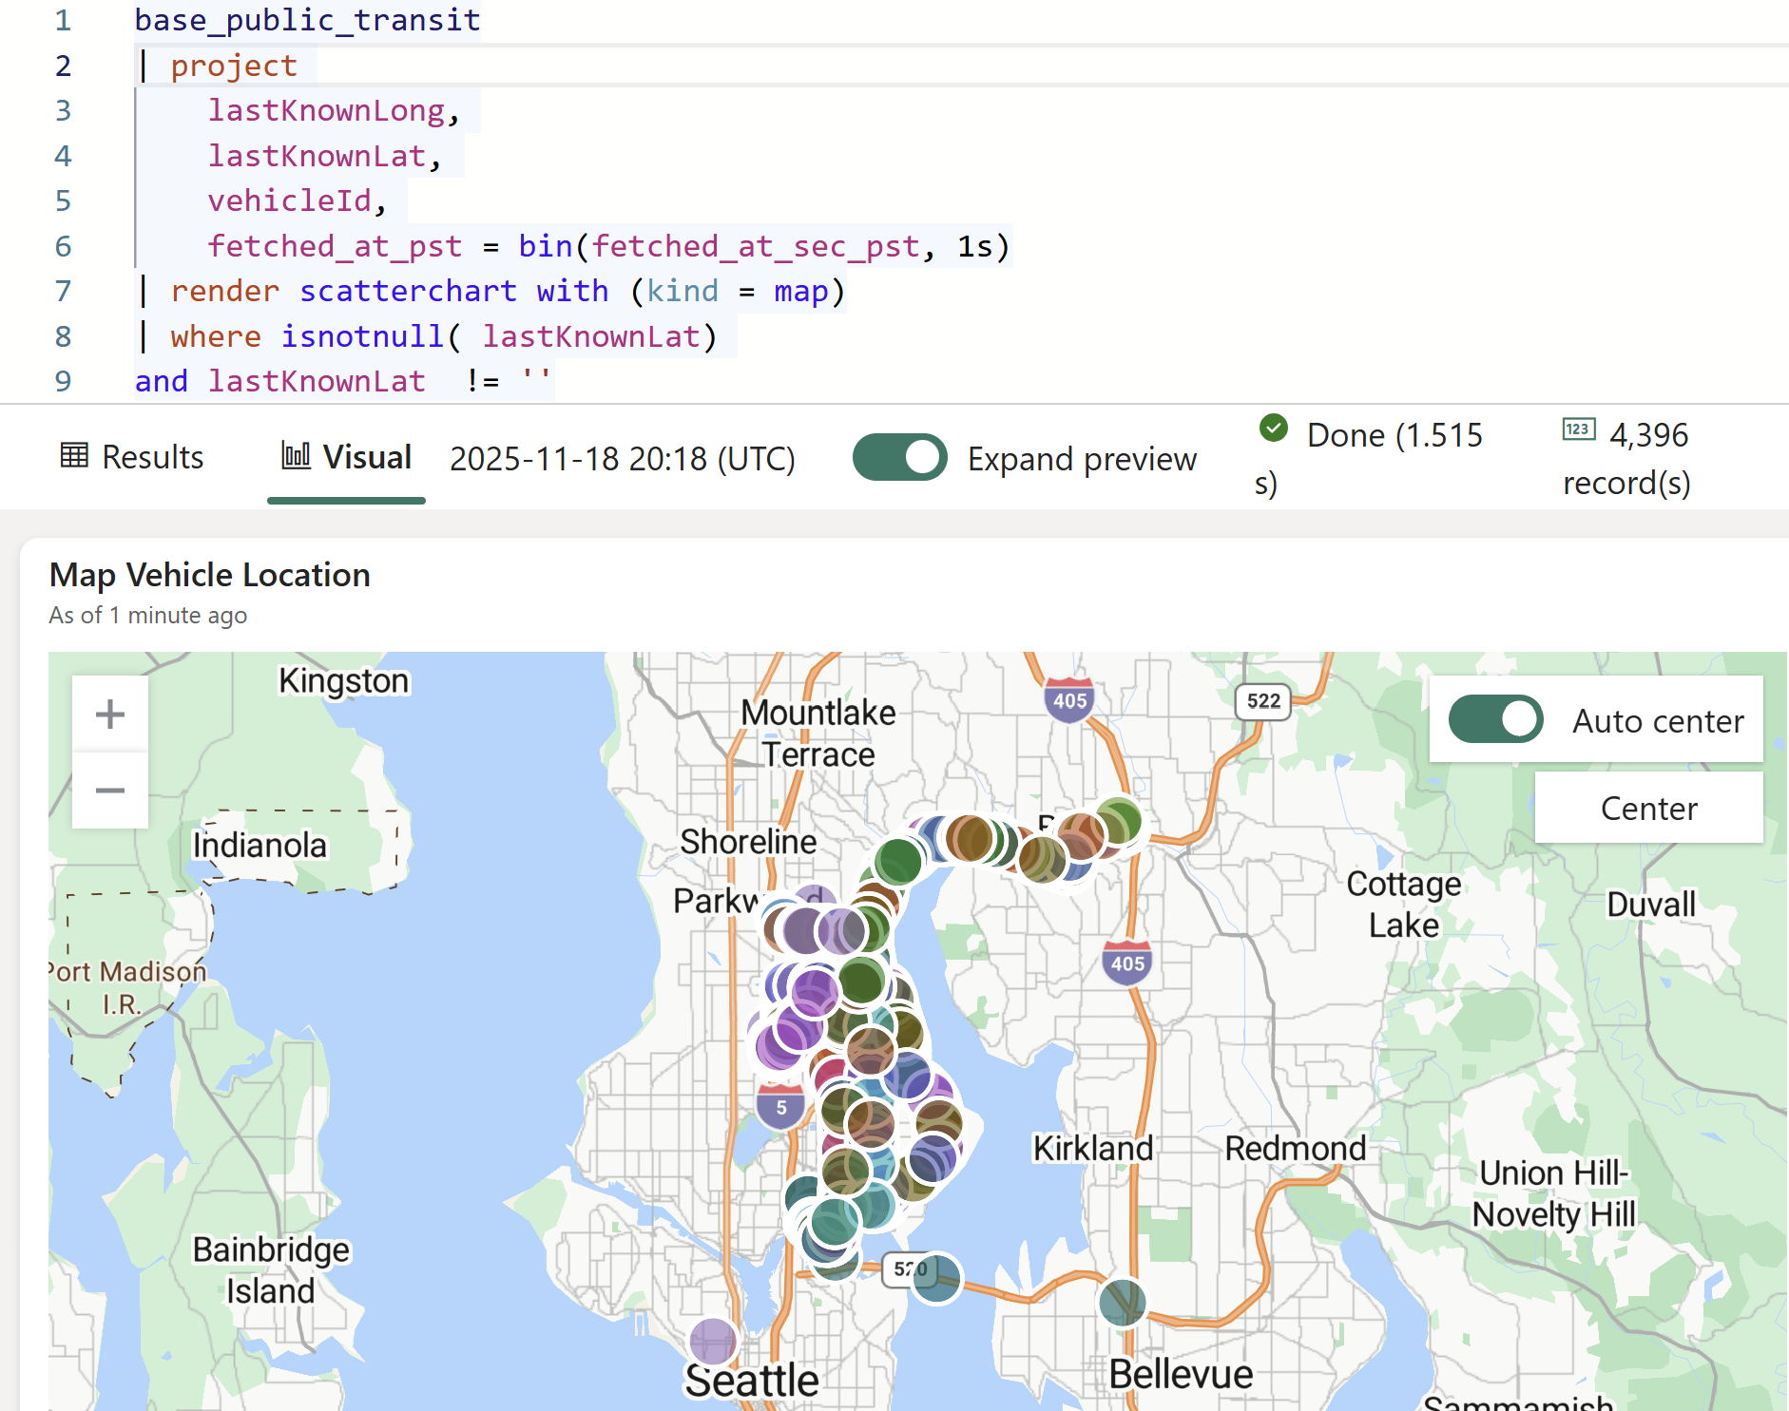
Fabric RTD KQL Basics for Visuals
Useful Commands
project
Specify what columns are returned
Can rename and add columns here
extend
Allows you to add calculated columns
where
Limits the data returned
sort by
Allows you to sort data appropriately
render
Allows you to display data
Notes:
KQL Quick Reference - Kusto | Microsoft Learn
Best practices for Kusto Query Language queries - Kusto | Microsoft Learn

Slide 7
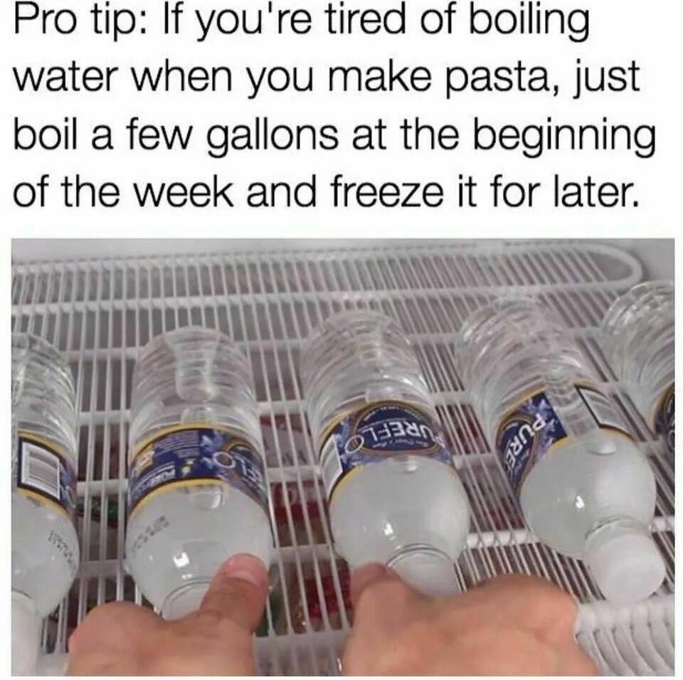
Fabric RTD Tips & Tricks
Use base queries
Utilize parameters as slicers
Conditional formatting is possible!
KQL is case sensitive for EVERYTHING
Keep query time windows tight. This is real-time, only include the time you need
Use summarized tables

Slide 8

Fabric RTD Limitations
Visuals do not interact with cross-highlighting / filtering
No drill-through nor bookmarks
No direct connection to SQL, Lakehouses, Delta, etc.
No custom visuals
No advanced theming
Only KQL queries are supported
No relational modeling (must be built into the KQL)
No export to PDF/PPT

Slide 9
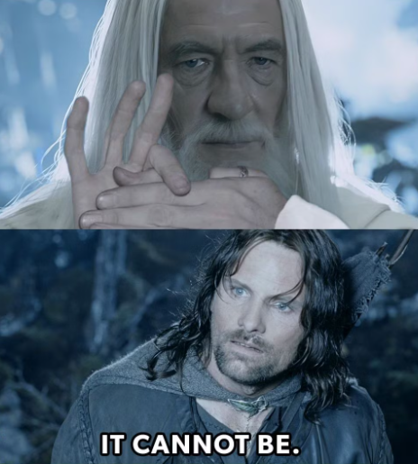
Demo Time!

Slide 10

Power BI Direct Query Report
Ideal Use Cases
Operational reporting where data latency of 30–60 seconds is acceptable.
Need to include data from other sources like enterprise SQL data warehouses
Traditional business dashboards (finance, sales, inventory) with near-real-time updates
Need to drill down deeper into the data records
Deeper analysis scenarios

Slide 11

Power BI DQ Limitations
Direct Query (DQ) sends queries directly to the source system for every visual. This can lead to the database being overwhelmed by interactions
Fastest page refresh is 1 second, requires admin approval
More users = more queries = more cost against the source system
Requires more ongoing tuning (indexing, query optimization, etc.) on the source system
No event-driven visual updates

Slide 12

Fabric RTD vs Power BI DQ
Feature | Fabric RTD | Power BI DQ
Latency | < 1 sec | >= 1 sec
Visual Interactions
Joining with Other Data
True Streaming Analytics
Event-Based Refreshes
Customized Visuals
Drill Throughs
Workspace App

Slide 13
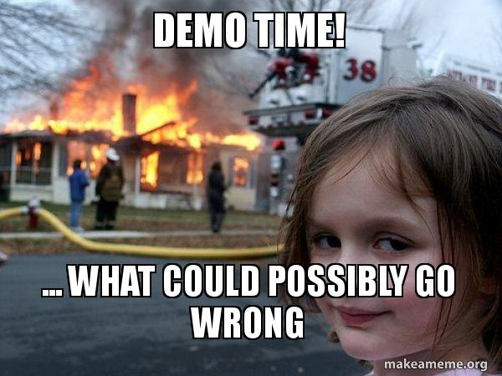

Slide 14
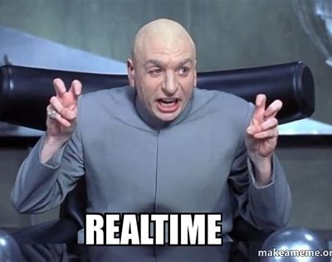
Do you need REAL time?
What would break if the dashboard was 5 minutes behind?
Who gets notified when something changes?
What action would need to happen immediately?
Is this a monitoring dashboard or a decision-making dashboard?
Will the dashboard actually be watched?
Is the end user human?

Slide 15
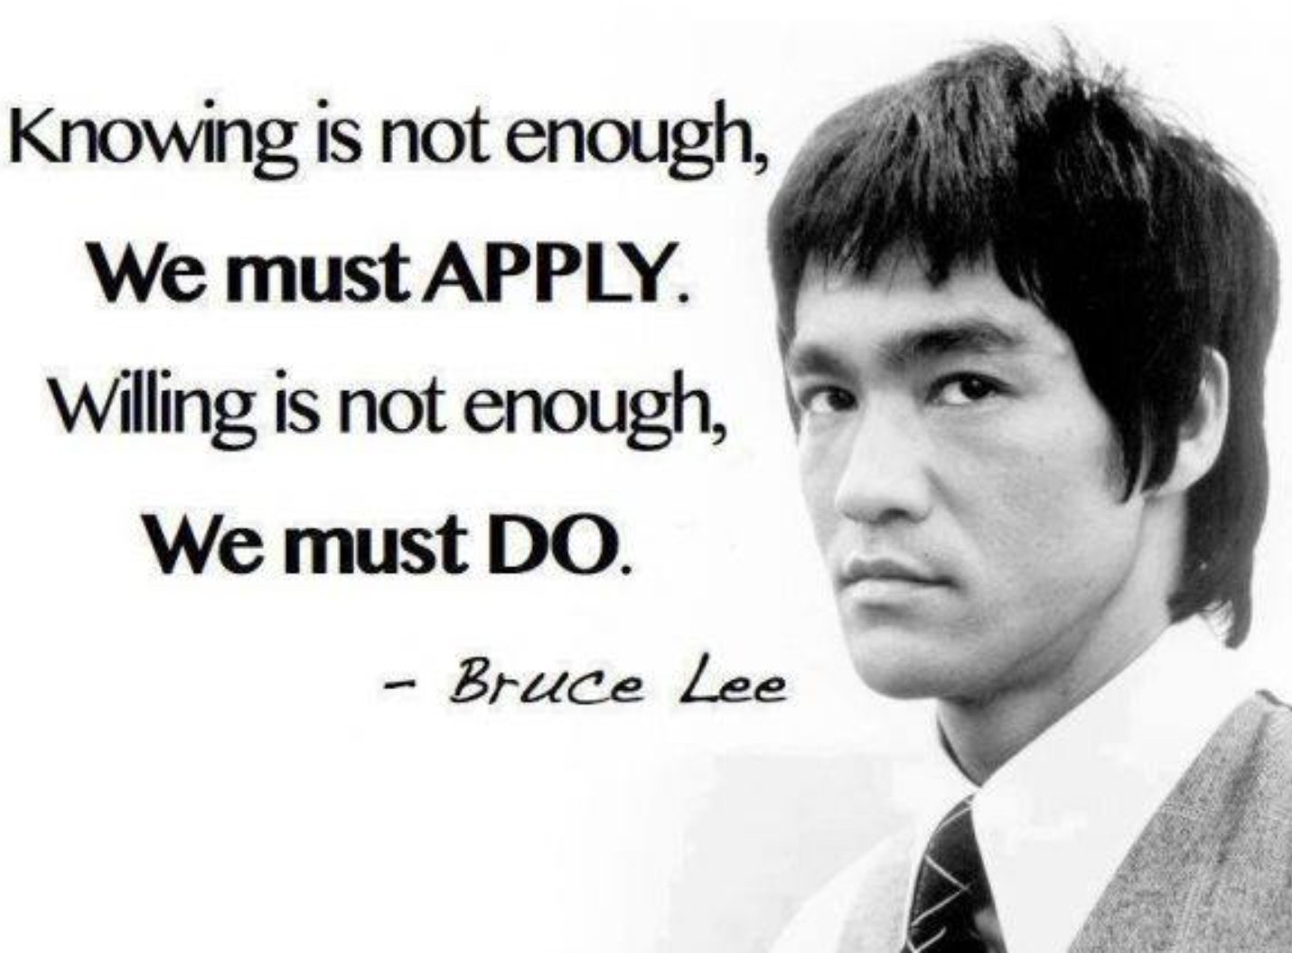
Don’t Skimp on the Story
Data without a story is just noise
Start with the business outcome, not the tech
Dashboards don’t change businesses, decisions do
Follow the hero’s journey
Ordinary World: What’s happening today? What’s normal/baseline?
Call to adventure: What happens to make things “go wrong”?
Trials: Why did the problem happen?
Crisis: What is impacted by the problem?
Return/Reward: How can we resolve the problem quickly to return to status quo?

Slide 16

Don’t forget to connect, thanks for listening!
https://dataonwheels.wordpress.com/
kristyna@dataonwheels.com
@data_dragoness
GitHub

Slide 17
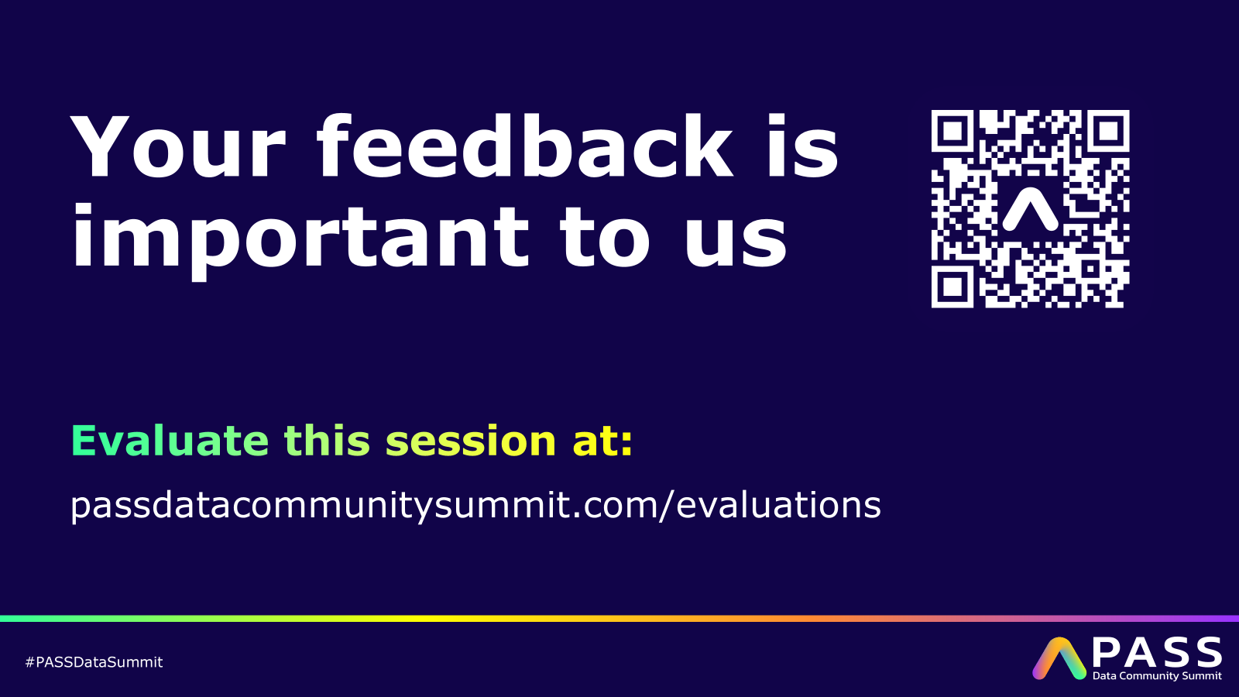
Don’t forget to connect, thanks for listening!

